Slide 1
Project Execution & Monitoring

Slide 2
Five Process Groups (PMBOK)
Initiating – Define the project and get authorization.
Planning – Establish scope, objectives, and course of action.
Executing – Perform the work defined in the plan.
Monitoring & Controlling – Track, review, and regulate progress.
Closing – Finalize all activities and formally close the project.

Slide 3
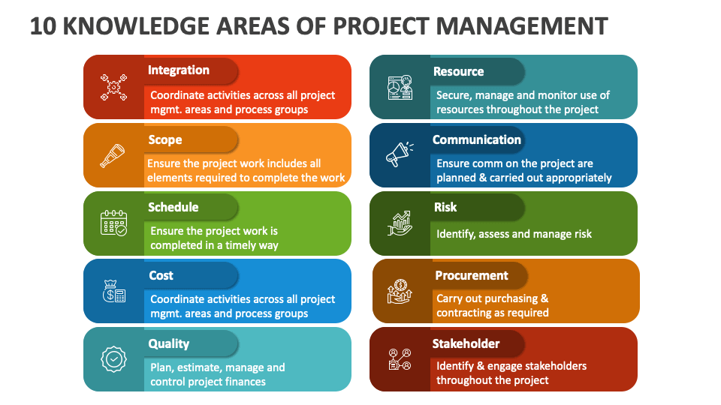

Slide 4
Project Management Frameworks (PMBOK, PRINCE2, Agile)
Framework | Key Features | Best Use Case
PMBOK | Process-based, comprehensive knowledge areas | Large-scale, structured projects
PRINCE2 | Governance, defined roles, stage-based | Projects requiring strict control
Agile | Iterative, flexible, customer-focused | Software development, dynamic environments
Notes:
Several frameworks guide IT project management, each offering unique principles and processes. PMBOK (Project Management Body of Knowledge) provides a process-based approach emphasizing knowledge areas like scope, time, and cost management. PRINCE2 (Projects IN Controlled Environments) is a structured methodology focusing on governance and control through defined roles and stages. Agile, on the other hand, promotes flexibility and iterative development, making it ideal for software projects where requirements evolve rapidly. Agile frameworks such as Scrum and Kanban enable continuous feedback and incremental delivery, reducing risks and improving customer satisfaction. For example, software development teams often adopt Agile to deliver features in short sprints, ensuring adaptability to changing business needs. Choosing the right framework depends on project complexity, stakeholder expectations, and organizational culture.

Slide 5
Resource Management
Resource Management is the process of identifying, acquiring, and managing resources (human, physical, and material) needed for successful project execution.
Objectives of Resource Management
Ensure right resources at the right time.
Optimize resource utilization.
Improve team performance and collaboration.
Manage conflicts and constraints.
Types of Resources
Human Resources: Project team members (developers, testers, PMs).
Physical Resources: Equipment, servers, software licenses.
Material Resources: Raw materials for hardware projects.
Financial Resources: Budget allocation.

Slide 6
Processes in Resource Management
Plan Resource Management
Definition: Define how to estimate, acquire, manage, and use resources.
Outputs: Resource Management Plan, RACI Matrix.
For a cloud migration project, PM plans roles (Cloud Architect, DevOps Engineer) and tools (AWS, Terraform).
Estimate Activity Resources
Definition: Determine the type and quantity of resources needed.
For a mobile app project, estimate:
3 developers
1 QA tester
2 servers for testing

Slide 7
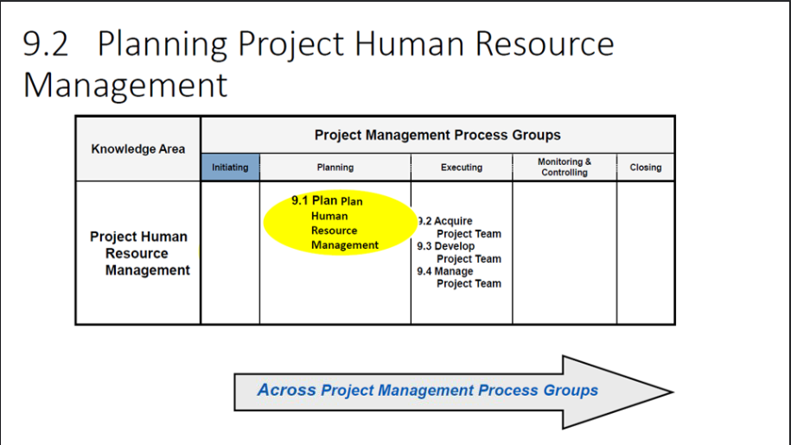

Slide 8
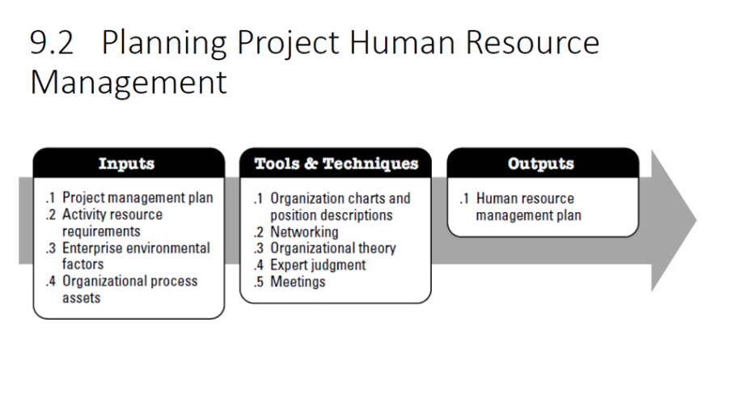

Slide 9
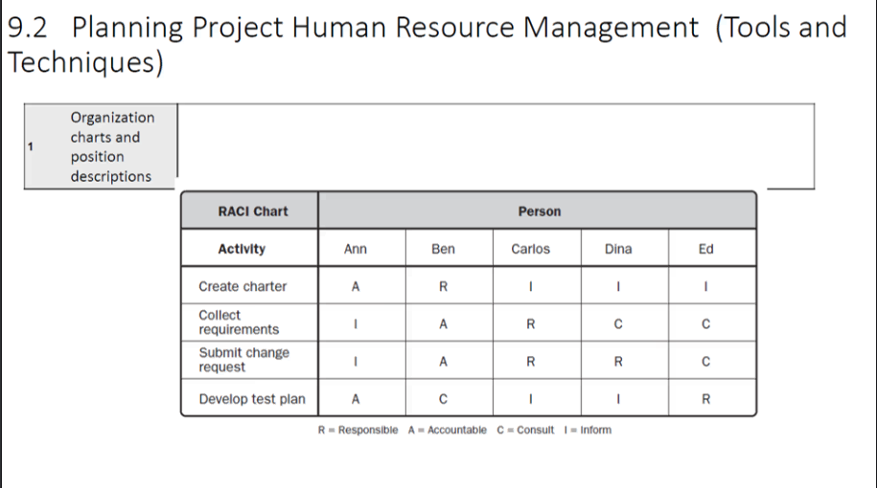

Slide 10
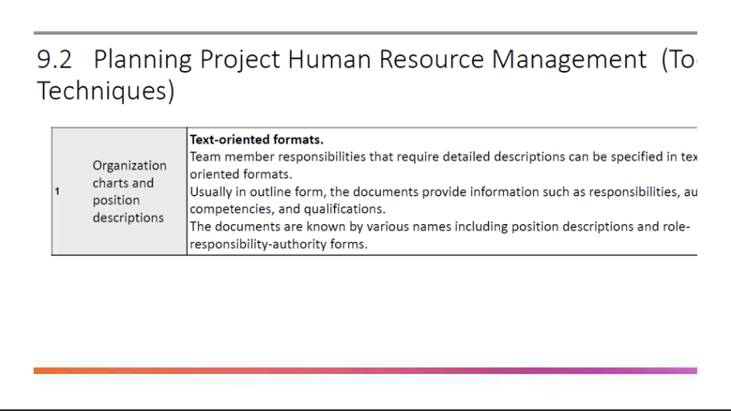

Slide 11
Processes in Resource Management
Acquire Resources
Definition: Obtain team members, equipment, and materials.
Example:
Hire AWS-certified engineers and procure cloud servers.
Develop Team
Definition: Improve team skills and cohesion.
Example:
Conduct Agile training for developers and testers.
Manage Team
Definition: Track performance, resolve conflicts, and motivate team.
Example:
PM uses Jira dashboards to monitor progress and resolves conflicts between developers.

Slide 12
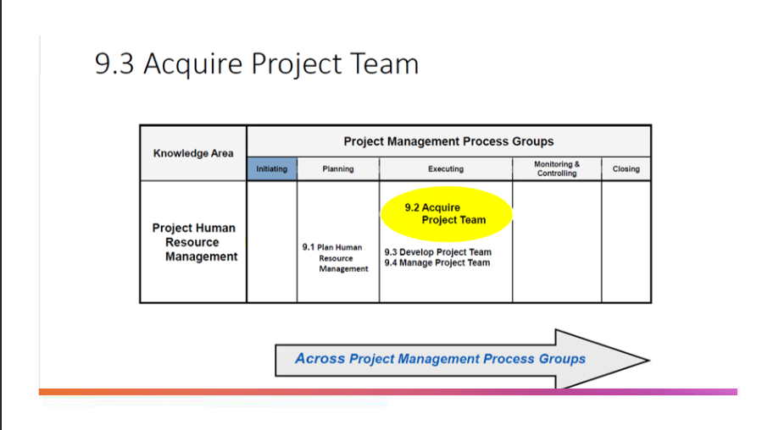

Slide 13
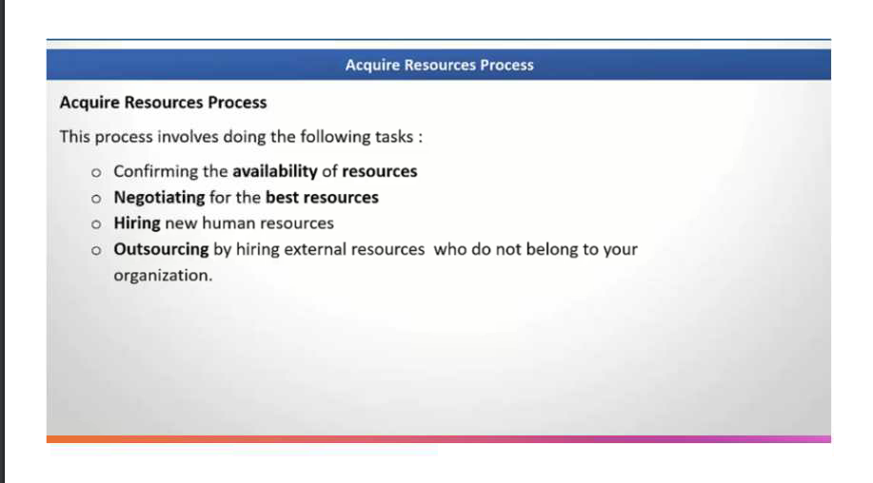

Slide 14
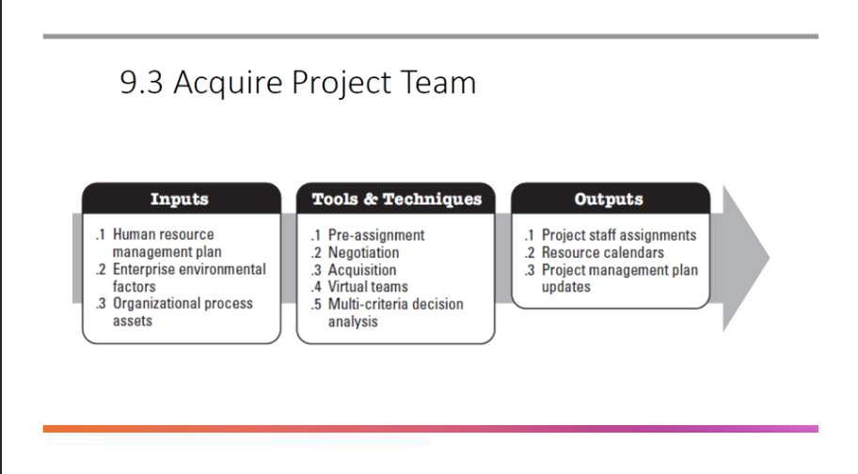

Slide 15
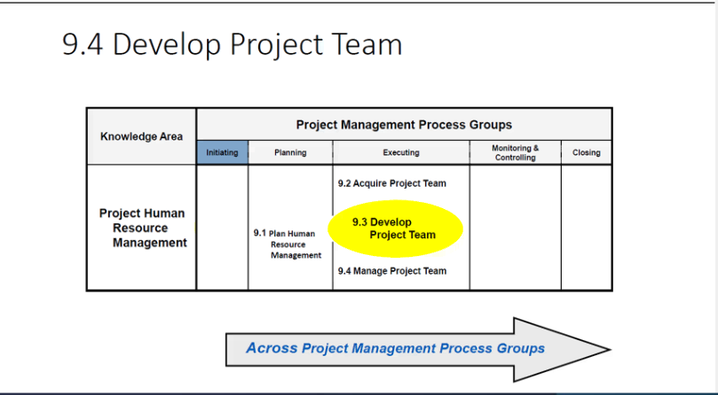

Slide 16
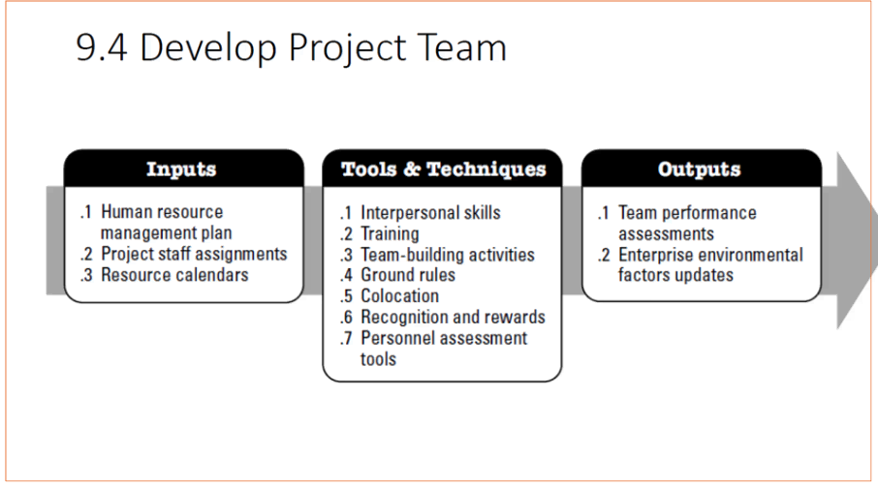

Slide 17
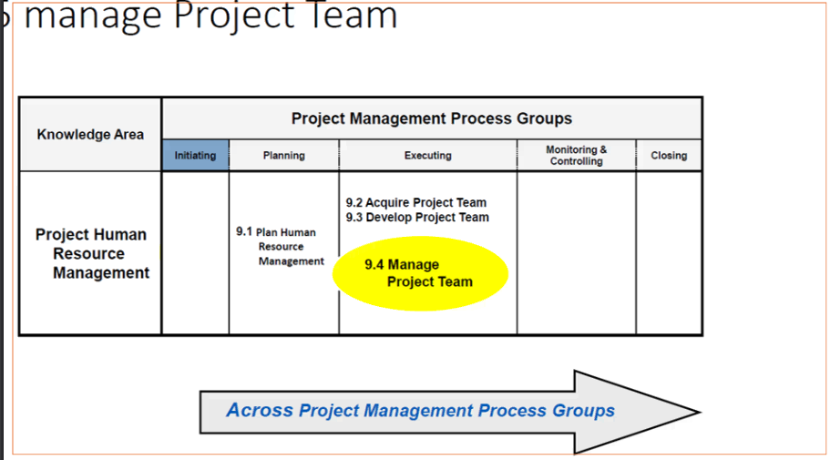

Slide 18
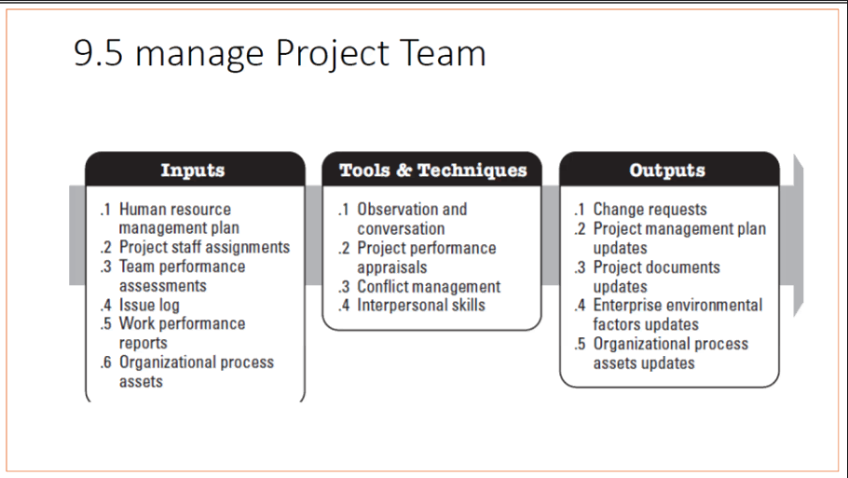

Slide 19
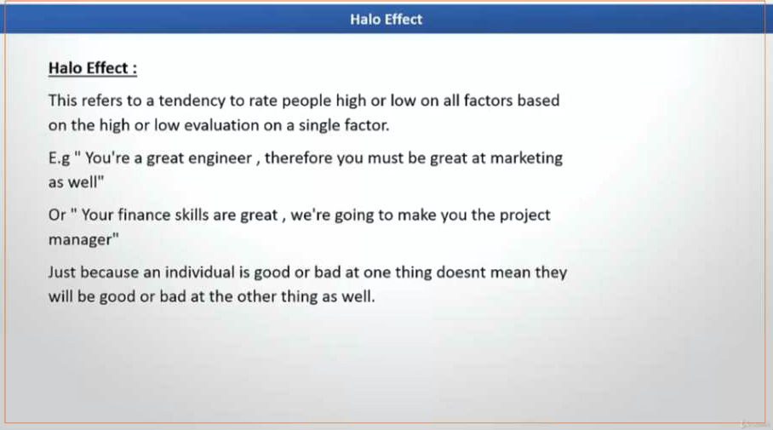

Slide 20
Processes in Resource Management
Control Resources
Definition: Ensure physical resources are available and used as planned.
Example:
Monitor server usage during performance testing to avoid cost overruns.
Tools & Techniques
RACI Matrix: Clarifies roles.
Resource Calendars: Shows availability.
Negotiation: For resource allocation.
Virtual Teams: For remote work.
Performance Reviews: For team evaluation.

Slide 21
Processes in Resource Management
Outputs
Resource Management Plan
Team Assignments
Resource Breakdown Structure (RBS)
Updates to project documents
Examples
IT Project Example:
Goal: Deploy an e-commerce platform.
Resources:
Human: Developers, QA, PM.
Physical: Servers, cloud storage.
Tools: Jira, GitHub, AWS.
Engineering College Example:
Goal: Build a new computer lab.
Resources:
Human: Civil engineers, electricians.
Physical: Computers, furniture.
Financial: Budget for construction.

Slide 22
Team Management
Activities:
Define roles and responsibilities.
Assign tasks based on skills.
Monitor performance and resolve conflicts.
Motivate and engage team members.
PMBOK Processes:
Acquire Resources
Develop Team
Manage Team
Example:
A project manager for a cloud migration project uses RACI Matrix to clarify roles and conducts weekly check-ins via Zoom.

Slide 23
Acquire Resources
These processes belong to the Project Resource Management Knowledge Area and occur mainly during Execution and Monitoring & Controlling phases.
The process of obtaining team members, equipment, materials, and facilities needed to complete the project.
Inputs:
Resource Management Plan
Procurement Documents
Project Schedule
Tools & Techniques:
Negotiation: With functional managers or vendors.
Pre-assignment: Assigning resources before project starts.
Virtual Teams: For remote work.
Multi-criteria Decision Analysis: Evaluate candidates based on skills, cost, availability.
Outputs:
Physical Resource Assignments
Project Team Assignments
Resource Calendars
Types of Resources:
Human Resources: Developers, testers, PMs.
Physical Resources: Servers, laptops, software licenses.
Example:
For a cloud migration project, PM negotiates with HR for skilled AWS engineers and procures cloud servers from AWS.

Slide 24
Develop Team
The process of improving competencies, team interaction, and overall team environment to enhance project performance.
Goal:
Build a high-performing team.
Tools & Techniques:
Training: Technical or soft skills.
Team-building Activities: Virtual games, workshops.
Recognition & Rewards: Motivate team members.
Colocation or Virtual Collaboration: Improve communication.
Communication Technology: Slack, MS Teams.
Outputs:
Team Performance Assessments
Updates to Resource Management Plan
Stages of Team Development (Tuckman Model):
Forming
Storming
Norming
Performing
Adjourning
Example:
In a software development project, PM organizes Agile workshops and uses daily stand-ups to improve collaboration.

Slide 25
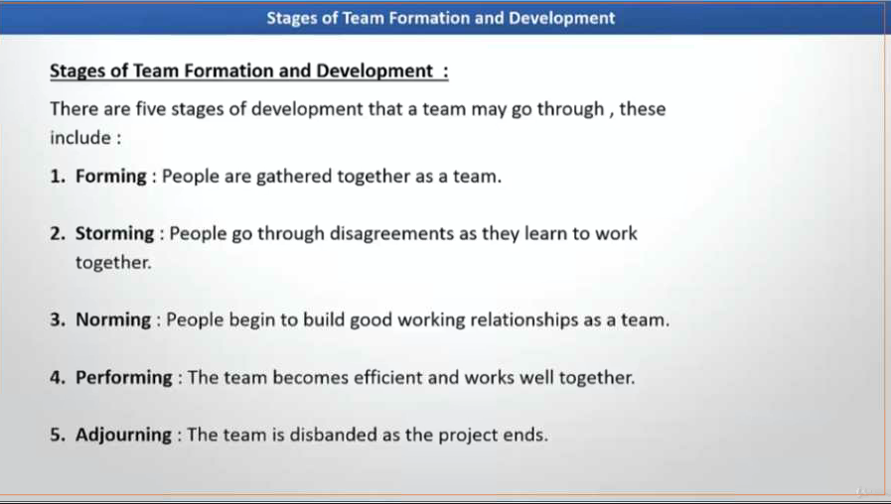

Slide 26
Team Building & Development - Storming
Conflict stage where team members challenge roles, processes, and
authority.
Characteristics:
Disagreements about tasks and priorities.
Power struggles.
Risk of low morale.
Example:
Developers argue about which framework to use (React vs Angular) for the front-end. PM mediates and sets clear guidelines.

Slide 27
Team Building & Development - Norming
Team starts to resolve conflicts, establish norms, and build trust.
Characteristics:
Clear roles and responsibilities.
Improved collaboration.
Agreement on processes.
Example:
The team agrees on coding standards, sets up Git branching strategy, and starts working smoothly.

Slide 28
Team Building & Development - Performing
Team reaches high productivity and autonomy. Focus is on achieving project goals.
Characteristics:
Strong collaboration.
Minimal supervision needed.
High efficiency.
Example:
The team delivers sprint goals consistently, automates testing, and integrates CI/CD pipelines without constant PM intervention.

Slide 29
Team Building & Development - Adjourning
Project ends, and the team disbands. Members move to new projects.
Characteristics:
Mixed emotions (pride + sadness).
Knowledge transfer and documentation.
Celebration of success.
Example:
After successfully launching the e-commerce platform, the team conducts a retrospective, shares lessons learned, and celebrates before moving to new assignments.

Slide 30
Manage Team
The process of tracking team performance, providing feedback, resolving issues, and managing changes to optimize project performance.
Activities:
Monitor team performance.
Handle conflicts.
Provide coaching and feedback.
Manage changes in team roles.
Tools & Techniques:
Conflict Management: Collaborate, compromise, force, smooth.
Performance Appraisals: Evaluate contributions.
Issue Logs: Track and resolve team issues.
Outputs:
Change Requests
Updates to Project Documents
Updates to Resource Management Plan
Example:
In a remote Agile team, PM uses Jira dashboards to monitor progress and resolves conflicts between developers over code ownership.

Slide 31
Relationship Between Processes
Acquire Resources: Get the right people and tools.
Develop Team: Build skills and team cohesion.
Manage Team: Ensure ongoing performance and resolve issues.
Real-World Example
Microsoft Azure Project:
Acquire: Hire cloud engineers.
Develop: Train on Azure DevOps.
Manage: Monitor performance via dashboards and resolve conflicts.

Slide 32
Types of Teams
Co-located Teams: All members work in the same physical location.
Remote Teams: Members work from different locations.
Hybrid Teams: Combination of on-site and remote members.
Cross-functional Teams: Members from different departments.
Virtual Teams: Entirely online collaboration.
Example:
Remote Team: A software company with developers in India and QA in the US.
Hybrid Team: PM and BA on-site, developers remote.

Slide 33
Challenges of Remote & Hybrid Teams
Challenges
Communication gaps.
Time zone differences.
Lack of face-to-face interaction.
Difficulty in monitoring performance.
Benefits:
Access to global talent.
Cost savings.
Flexibility for employees.

Slide 34
Tools Used in Remote & Hybrid Teams
Communication: Zoom, MS Teams, Slack.
Collaboration: Confluence, Google Workspace.
Project Management: Jira, Trello, Asana.
Version Control: GitHub, GitLab.
Time Tracking: Toggl, Clockify.
Example:
Agile team uses Jira for sprint planning, Slack for daily communication, and Zoom for retrospectives.

Slide 35
Team Management in IT Projects (Remote & Hybrid Teams)
Team management involves organizing, motivating, and coordinating project team members to achieve project objectives.
Key Activities:
Resource Allocation: Assign tasks based on skills.
Communication: Use tools like Slack, MS Teams, Zoom.
Conflict Resolution: Address issues promptly.
Performance Monitoring: Regular check-ins and feedback.
Remote & Hybrid Team Challenges:
Time zone differences.
Communication gaps.
Maintaining engagement.
Best Practices:
Daily stand-ups (Agile).
Clear roles and responsibilities (RACI Matrix).
Collaboration tools (Jira, Confluence, Trello).
Example:
A software company managing a cloud migration project with developers in India, QA in the US, and PM in Europe uses Scrum ceremonies and Zoom meetings to stay aligned

Slide 36
RACI Matrix
The RACI Matrix is a responsibility assignment chart used in project management to clarify roles and responsibilities for tasks and deliverables.
RACI stands for:
R – Responsible: The person who does the work.
A – Accountable: The person who owns the outcome and makes decisions.
C – Consulted: People who provide input or expertise.
I – Informed: People who need updates on progress.
Purpose of RACI Matrix
Avoid confusion about roles.
Improve communication.
Ensure accountability.
Align stakeholders.

Slide 37
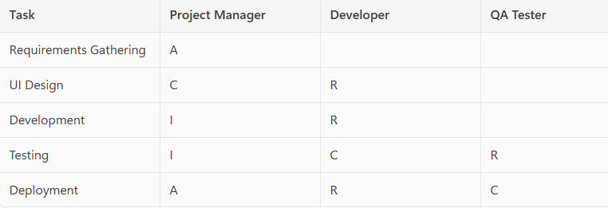
Example: IT Project (Website Development)

Slide 38
Conflict in Project Management
Conflict is a disagreement or clash of interests, ideas, or values among project stakeholders or team members.
Why does it occur?
Competing priorities.
Resource constraints.
Personality differences.
Miscommunication.
Scope changes.
PMBOK Context:
Conflict is common in Execution phase when resources and tasks are actively managed.

Slide 39
Common Sources of Conflict
Schedules: Deadlines and priorities.
Resources: Limited availability.
Technical Opinions: Different approaches.
Costs: Budget constraints.
Personal Values: Cultural or ethical differences.

Slide 40
Conflict Management
The process of handling disagreements constructively to maintain team harmony and project progress.
Goal:
Minimize negative impact.
Promote collaboration.
Ensure project objectives are met.

Slide 41
Types of Conflict Management Techniques
Collaborating (Problem-Solving)
Win-Win approach.
Both parties work together to find a solution.
Example: Developers and testers agree on a shared testing timeline.
Compromising
Each party gives up something.
Example: PM reduces scope slightly; client agrees to extend deadline.
Forcing (Directing)
One party imposes a solution.
Example: PM mandates using a specific tool due to compliance.
Avoiding (Withdrawal)
Ignoring the conflict temporarily.
Example: PM postpones discussion until more data is available.
Smoothing (Accommodating)
Emphasizing common goals and downplaying differences.
Example: PM highlights shared objective of project success to calm tensio

Slide 42
When to Use Each Technique
Collaborating: Best for long-term solutions.
Compromising: When time is limited.
Forcing: In emergencies or compliance issues.
Avoiding: When issue is minor or needs more info.
Smoothing: To maintain harmony temporarily.

Slide 43
Example Scenario
Conflict:
Two developers disagree on using React vs Angular for UI.
Collaborating: Analyze pros/cons and choose best fit.
Compromising: Use React for core modules, Angular for admin panel.
Forcing: PM decides React due to client preference.
Avoiding: Delay decision until architecture review.
Smoothing: PM reminds team of shared goal: delivering on time.

Slide 44
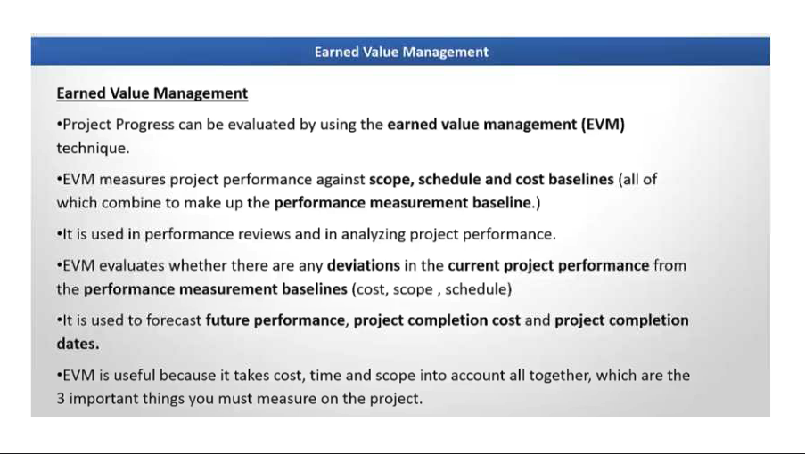

Slide 45
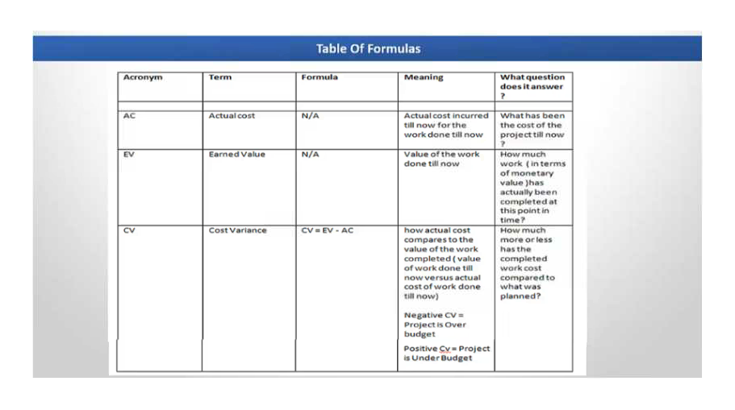

Slide 46
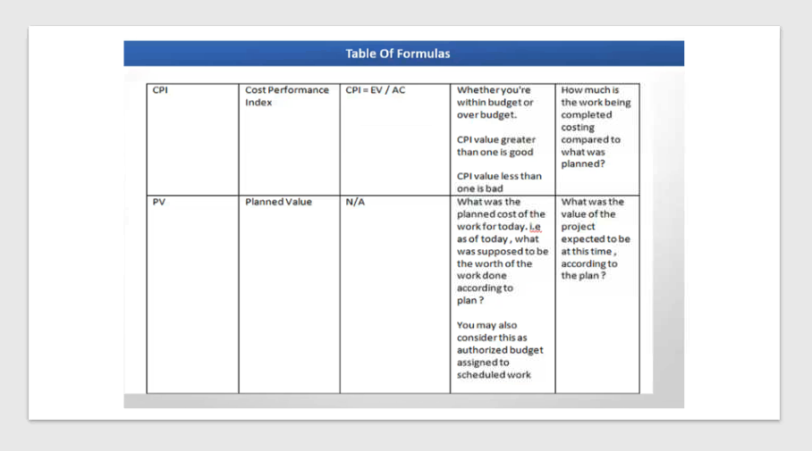

Slide 47
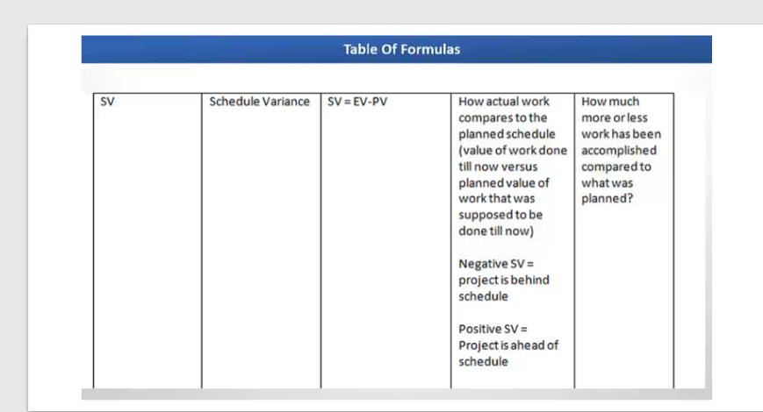

Slide 48
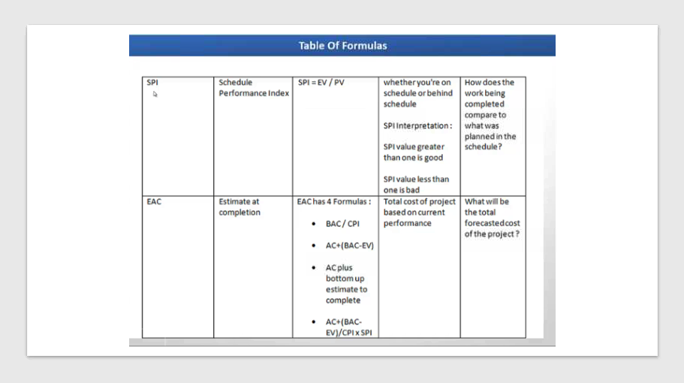

Slide 49
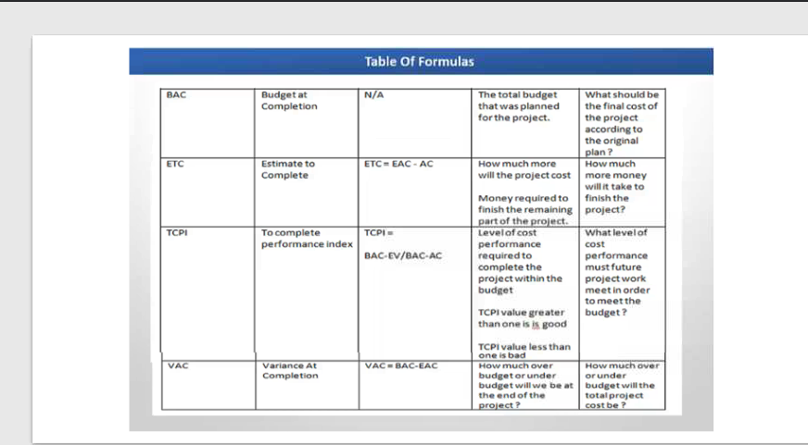

Slide 50
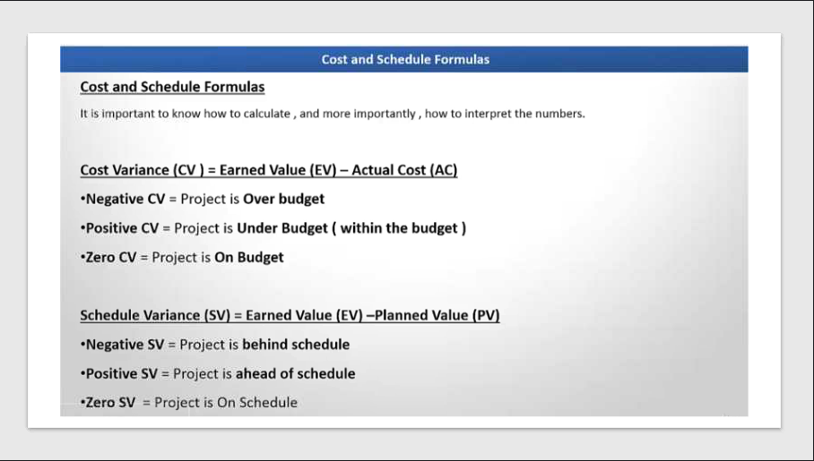

Slide 51
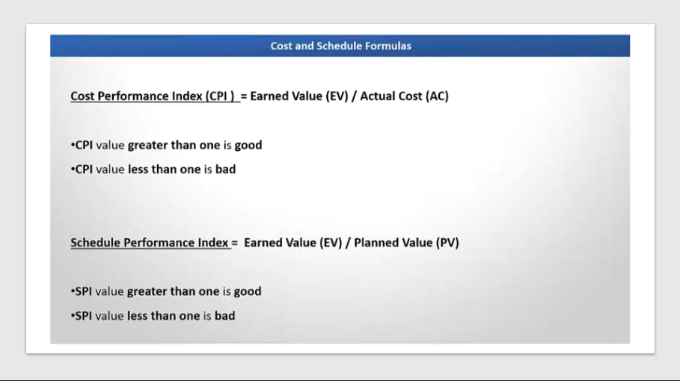

Slide 52
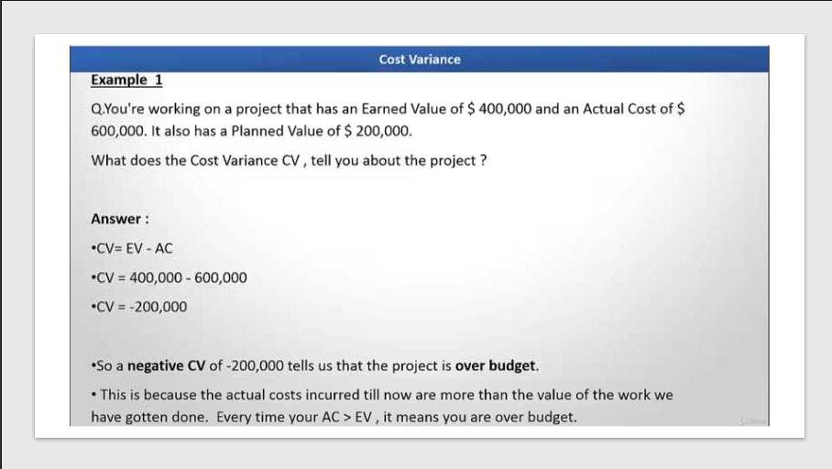

Slide 53
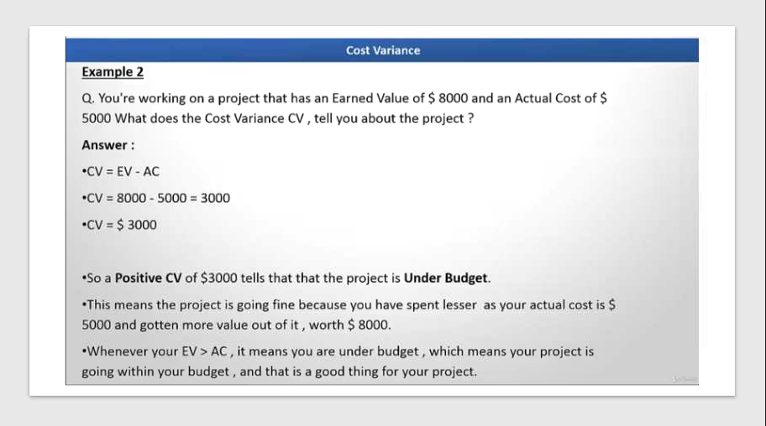

Slide 54
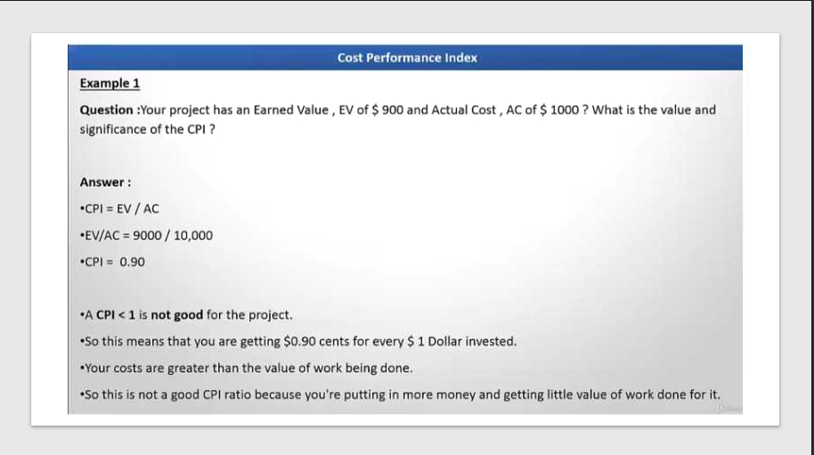

Slide 55
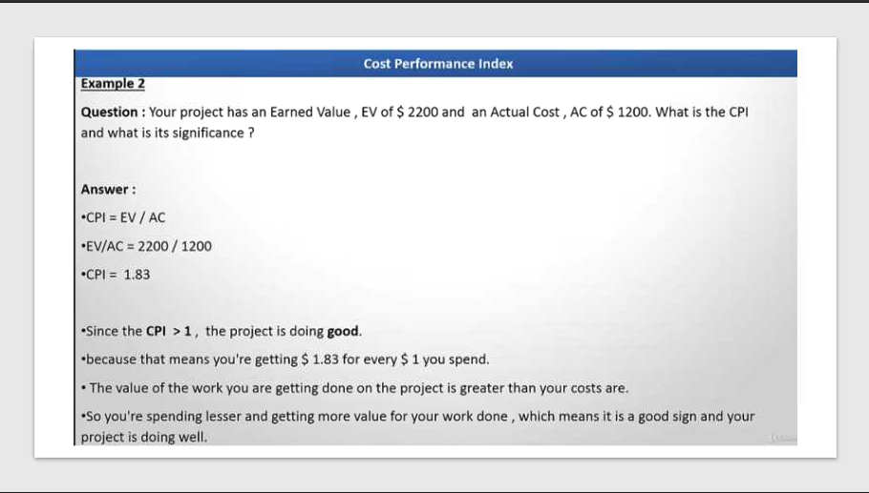

Slide 56
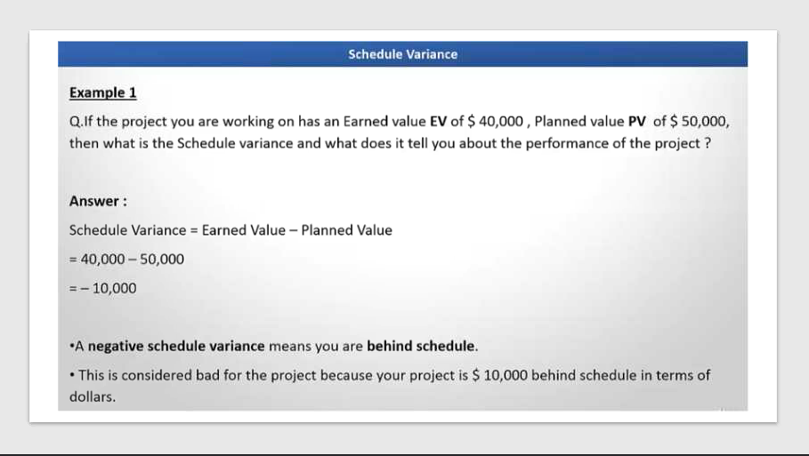

Slide 57
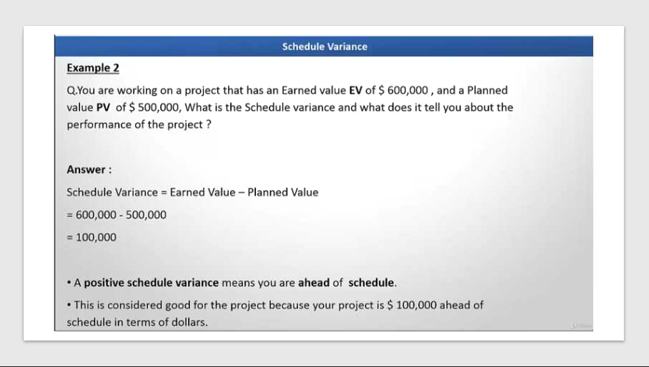

Slide 58
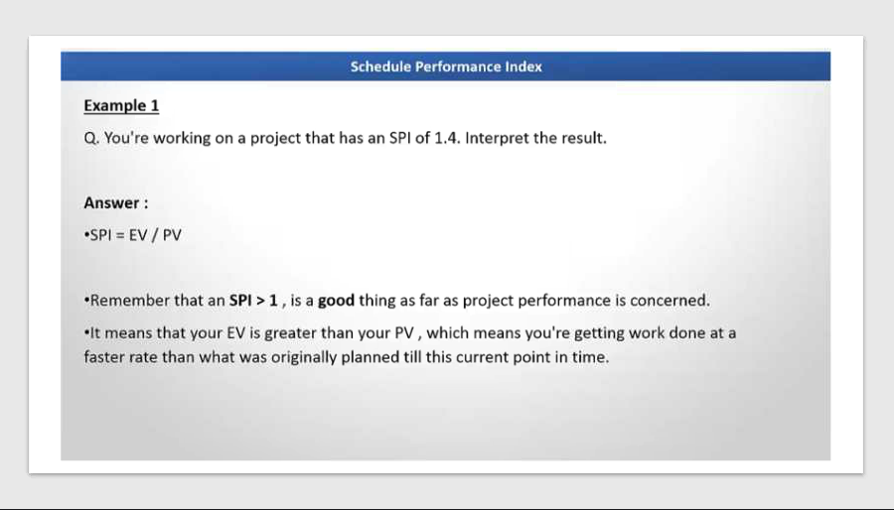

Slide 59
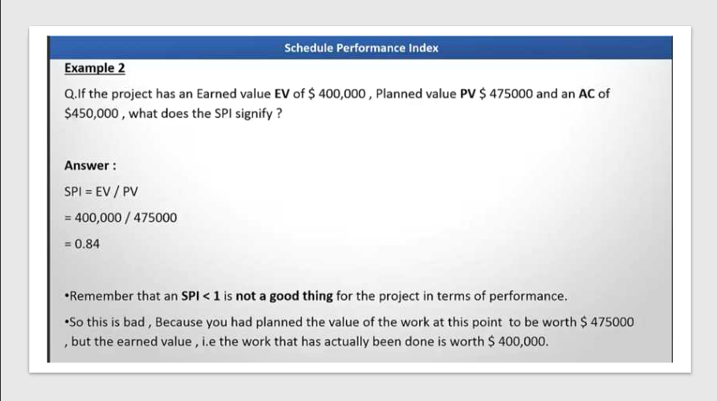

Slide 60
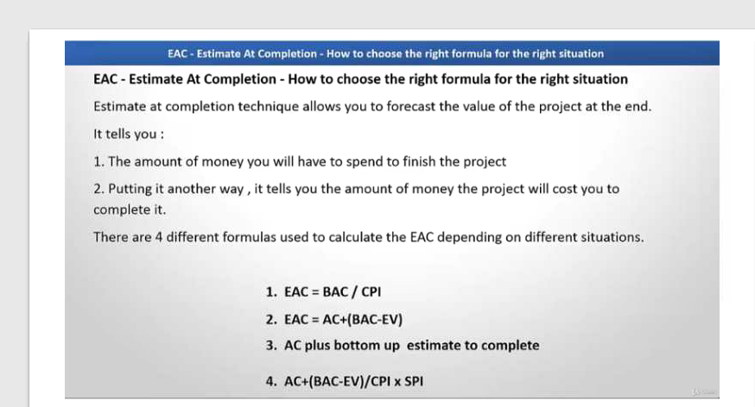

Slide 61
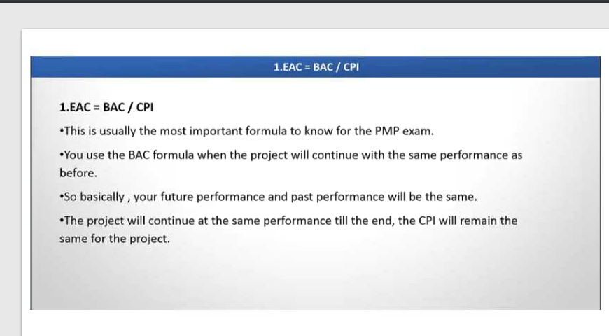

Slide 62
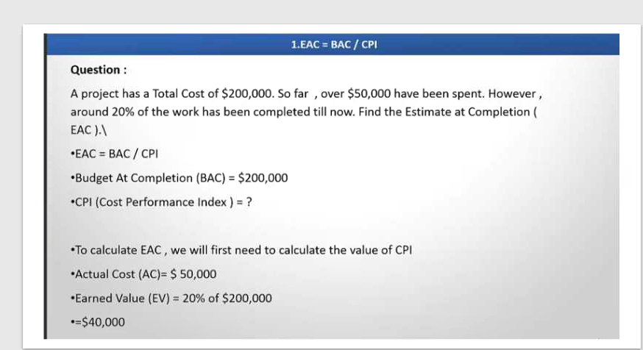

Slide 63
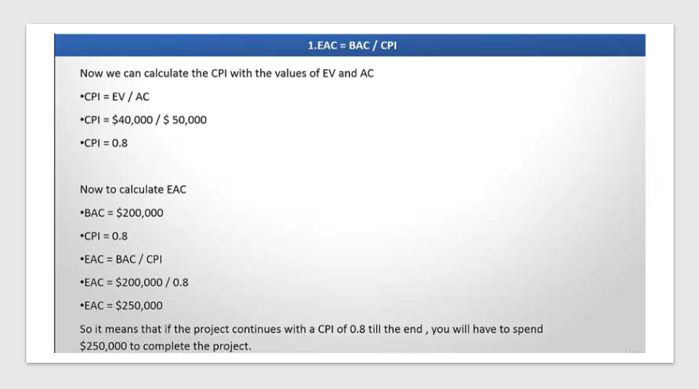

Slide 64
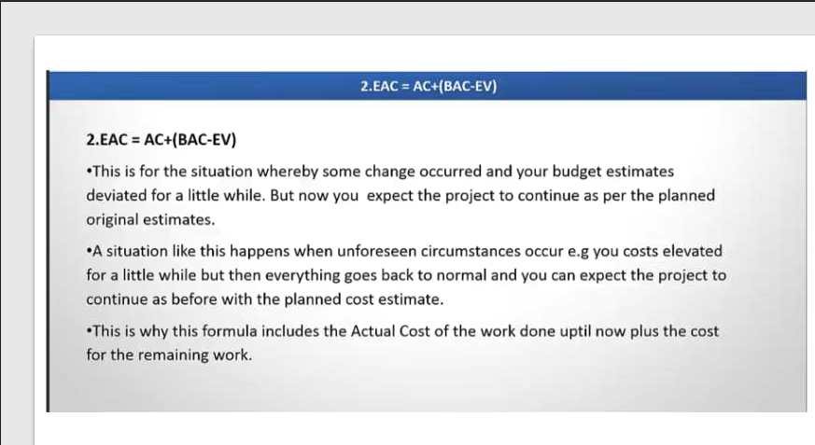

Slide 65
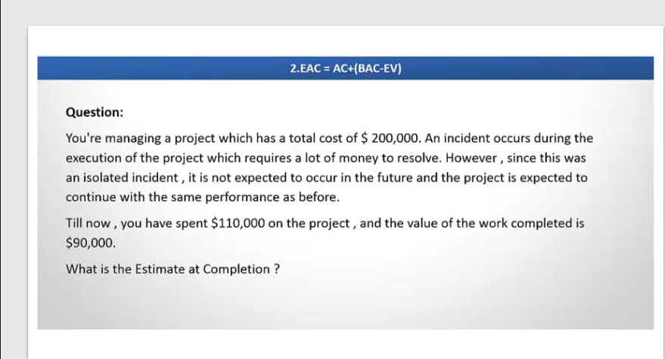

Slide 66
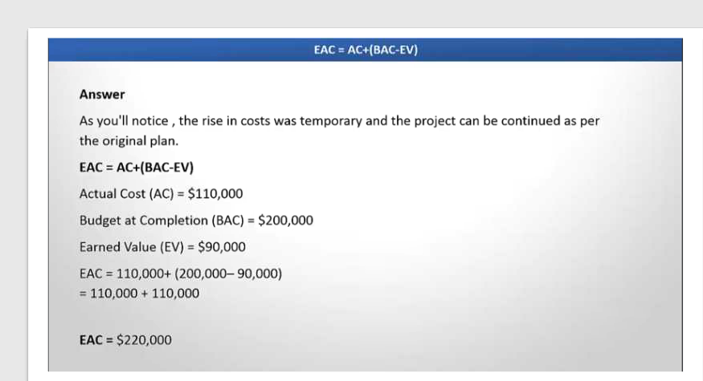

Slide 67
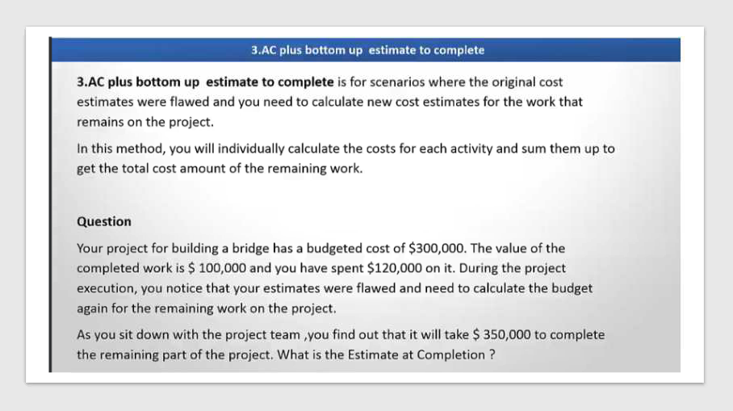

Slide 68
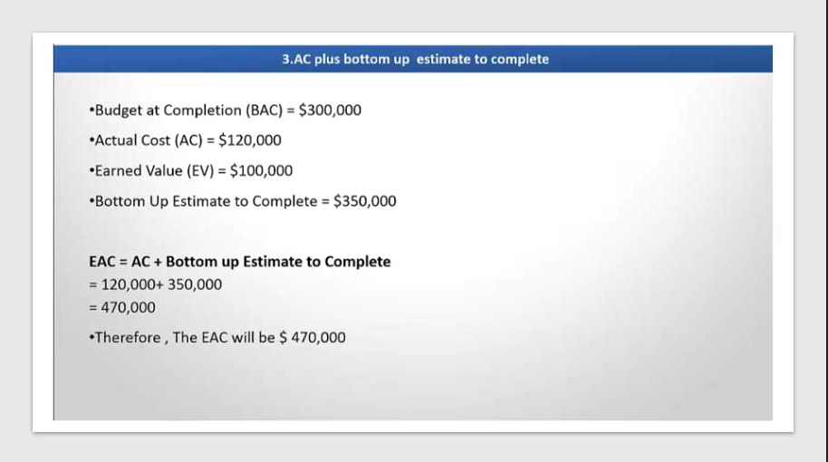

Slide 69
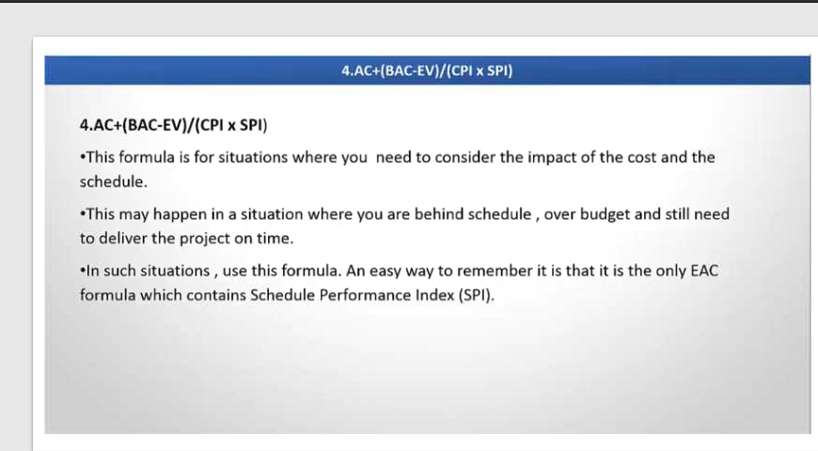

Slide 70
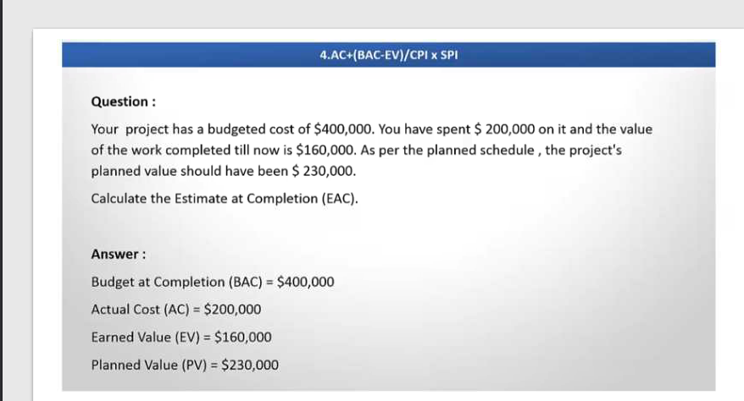

Slide 71
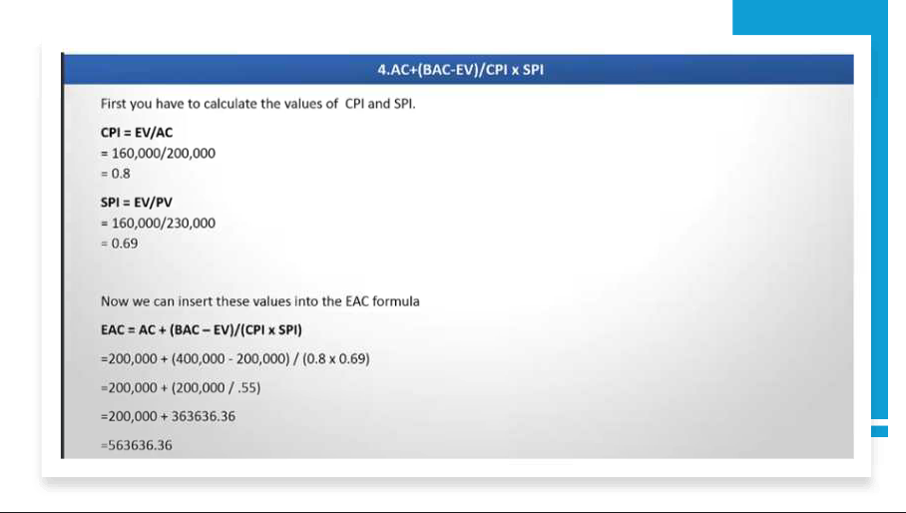

Slide 72
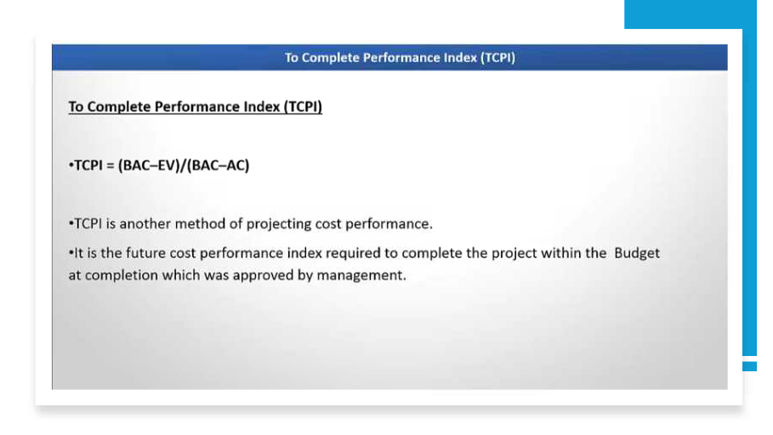

Slide 73
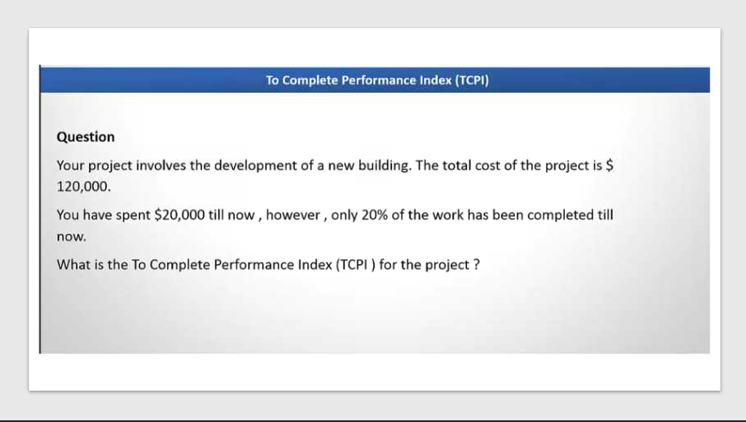

Slide 74
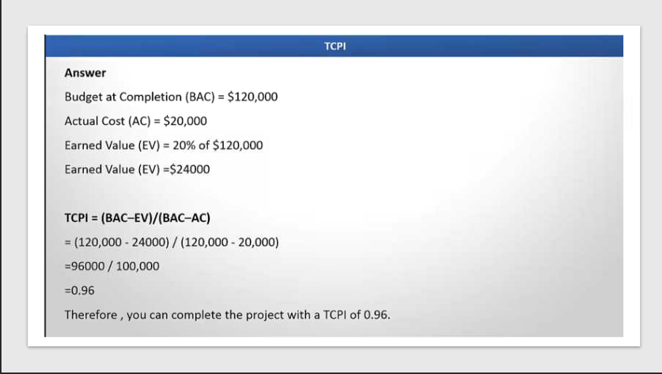

Slide 75
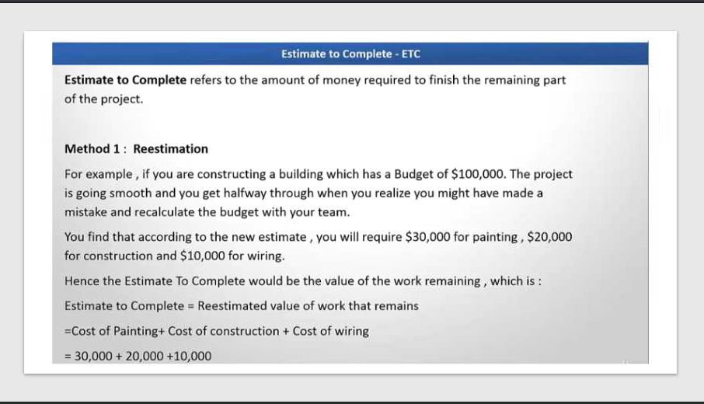

Slide 76
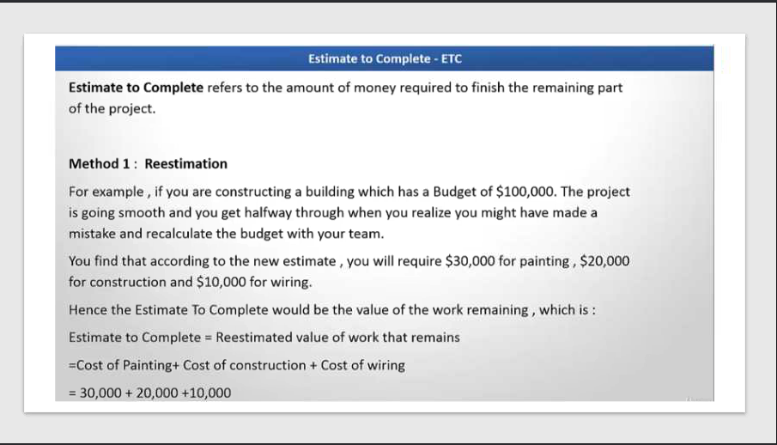

Slide 77
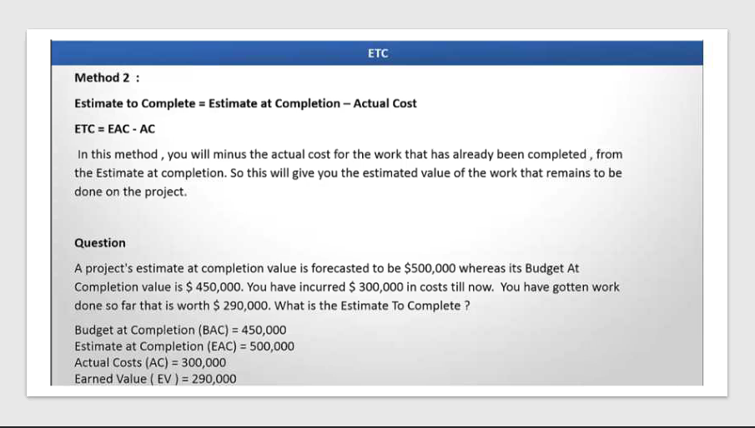

Slide 78
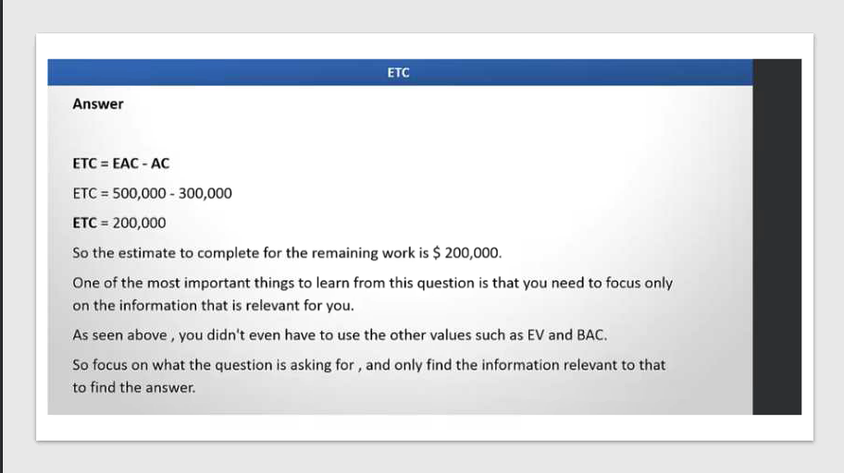

Slide 79
Tracking Progress in IT Projects
Tracking progress ensures the project stays on scope, schedule, and budget. PMBOK recommends performance measurement techniques like EVM and Agile metrics (Burn-down charts).
Earned Value Management (EVM)
EVM integrates scope, schedule, and cost to measure project performance.
Key Terms:
Planned Value (PV): Budgeted cost for work scheduled.
Earned Value (EV): Budgeted cost for work completed.
Actual Cost (AC): Actual cost incurred.
Key Formulas:
Cost Variance (CV): EV – AC
Schedule Variance (SV): EV – PV
Cost Performance Index (CPI): EV ÷ AC
Schedule Performance Index (SPI): EV ÷ PV

Slide 80
Example 1: Website Development Project
PV = $50,000 (planned by month 3)
EV = $40,000 (work completed)
AC = $45,000 (actual spent)
Calculations:
CV = EV – AC = $40,000 – $45,000 = –$5,000 (Over budget)
SV = EV – PV = $40,000 – $50,000 = –$10,000 (Behind schedule)
CPI = EV ÷ AC = 40,000 ÷ 45,000 = 0.89 (Cost efficiency < 1)
SPI = EV ÷ PV = 40,000 ÷ 50,000 = 0.8 (Schedule efficiency < 1)
Interpretation:
Project is over budget and behind schedule.

Slide 81
Example 2: Cloud Migration Project
PV = $100,000
EV = $120,000
AC = $110,000
Calculations:
CV = 120,000 – 110,000 = $10,000 (Under budget)
SV = 120,000 – 100,000 = $20,000 (Ahead of schedule)
CPI = 120,000 ÷ 110,000 = 1.09
SPI = 120,000 ÷ 100,000 = 1.2
Interpretation:
Project is ahead of schedule and under budget.

Slide 82
Example 3: Mobile App Development
PV = $30,000
EV = $25,000
AC = $20,000
Calculations:
CV = 25,000 – 20,000 = $5,000 (Under budget)
SV = 25,000 – 30,000 = –$5,000 (Behind schedule)
CPI = 25,000 ÷ 20,000 = 1.25
SPI = 25,000 ÷ 30,000 = 0.83
Interpretation:
Project is under budget but behind schedule.

Slide 83
Burn-down Charts (Agile)
A Burn-down Chart is a graphical representation of work remaining versus time in an Agile project.
It helps teams visualize progress toward completing a sprint or release.
Purpose
Track progress of work during a sprint.
Predict whether the team will meet the sprint goal.
Identify delays or bottlenecks early.
Improve transparency for stakeholders.

Slide 84

Structure of a Burn-down Chart

Slide 85
Structure of a Burn-down Chart
Structure of a Burn-down Chart
X-axis: Time (days in sprint).
Y-axis: Work remaining (story points, tasks, or hours).
Ideal Line: Shows expected progress if work is completed evenly.
Actual Line: Shows real progress.
Benefits
Transparency: Everyone sees progress clearly.
Early Warning: Detect delays before sprint ends.
Motivation: Visual progress encourages team performance.
Improved Planning: Helps forecast future sprints.
Stakeholder Communication: Simple visual for non-technical stakeholders.
How It Works
At the start of the sprint, total work (e.g., 100 story points) is plotted.
Each day, completed work reduces the remaining amount.
The chart updates daily to show progress.

Slide 86
Example
Ideal Progress
Sprint: 10 days
Total work: 100 story points
Day 1: 100 points
Day 5: 50 points
Day 10: 0 points Interpretation: Team is on track.
Behind Schedule
Sprint: 14 days
Total work: 80 tasks
Day 7: 70 tasks remaining
Day 14: 30 tasks remaining Interpretation: Team is behind; may need scope adjustment.
Ahead of Schedule
Sprint: 7 days
Total work: 50 tasks
Day 3: 20 tasks remaining
Day 7: 0 tasks remaining Interpretation: Team finished early; can take extra work or improve quality.
Best Practices
Update chart daily.
Use consistent units (story points or tasks).
Combine with burn-up charts for scope changes.
Share chart in daily stand-ups.

Slide 87
Tools for Burn-down Charts
Jira
Trello
Azure DevOps
Rally
Excel (manual chart)
Real-World Example
In a mobile app development sprint, the team starts with 100 story points.
By day 5, they have 60 points left, and by day 10, 10 points left.
The burn-down chart shows they are slightly behind but can recover with extra effort.

Slide 88
Other
Burn-up Charts
Purpose: Shows work completed vs total scope.
Benefit: Highlights scope changes during the sprint or release.
Example: If new stories are added mid-sprint, burn-up chart reflects the increase.
Cumulative Flow Diagram (CFD)
Purpose: Visualizes workflow states (To Do, In Progress, Done).
Benefit: Detects bottlenecks and flow efficiency.
Example: If “In Progress” area grows, team may be overcommitting.
Velocity Chart
Purpose: Tracks story points completed per sprint.
Benefit: Helps forecast future sprint capacity.
Example: Team averages 40 points per sprint → plan next sprint accordingly.
Control Charts
Purpose: Shows cycle time for work items.
Benefit: Measures predictability and process stability.
Example: If cycle time fluctuates, team needs to improve workflow consistency.

Slide 89
Other
Sprint Reports / Dashboards
Tools: Jira, Azure DevOps, Rally, Trello.
Benefit: Real-time visibility of sprint progress, burndown, and issues.
Kanban Board
Purpose: Visual representation of tasks in columns (To Do, In Progress, Done).
Benefit: Easy to track work status and WIP limits.
Example: Trello or Jira Kanban board for backlog management.
Epic & Release Progress Reports
Purpose: Tracks progress at a higher level (features, epics).
Benefit: Aligns team work with product roadmap.
Task Boards in Daily Stand-ups
Purpose: Manual or digital boards updated daily.
Benefit: Quick visual check of progress.

Slide 90
Quality Assurance and Testing in IT Projects
Quality Assurance (QA):
A process-oriented approach to ensure that project processes and deliverables meet defined quality standards.
Testing:
Key Aspects of Quality:
Conformance to Requirements
Deliverables must meet the specified standards and agreed requirements without deviation.
Fitness for Use
The product or service should be practical, reliable, and suitable for its intended purpose.
Stakeholder Satisfaction
Quality ensures that customers and stakeholders are happy with the outcome and their expectations are met.
Consistency
Processes and outputs should be uniform and repeatable, maintaining the same level of quality over time.
A product-oriented activity to verify that the deliverable works as intended.
Project Quality Management, which includes:
Plan Quality Management
Manage Quality (QA)
Control Quality (Testing)

Slide 91
Objectives
Ensure deliverables meet customer requirements.
Prevent defects rather than just detecting them.
Improve process efficiency and product reliability.
Comply with standards (ISO, CMMI, IEEE).
Key Concepts
Quality Assurance:
Focus on process improvement.
Activities: Audits, process compliance checks.
Quality Control (Testing):
Focus on product verification.
Activities: Inspections, functional and non-functional testing.

Slide 92
Project Quality Management
Plan Quality Management:
Define quality standards and metrics.
Example: Define response time < 2 sec for web app.
Manage Quality (QA):
Implement processes to meet standards.
Example: Conduct code reviews, process audits.
Control Quality (Testing):
Monitor and verify deliverables.
Example: Perform load testing using JMeter.

Slide 93
Types of Testing in IT Projects
Functional Testing: Verify features (e.g., login works).
Integration Testing: Check module interactions.
System Testing: Validate end-to-end functionality.
User Acceptance Testing (UAT): Client validation.
Performance Testing: Load, stress, scalability.
Security Testing: Vulnerability checks.
Regression Testing: Ensure changes don’t break existing features.

Slide 94
Examples
E-commerce Website:
QA: Define coding standards, review sprint deliverables.
Testing: Selenium for UI automation, JMeter for load testing.
Banking App:
QA: ISO 27001 compliance audit.
Testing: Penetration testing for security.

Slide 95
Tools Used
QA Tools:
Jira (Defect tracking)
Confluence (Documentation)
SonarQube (Code quality)
Testing Tools:
Selenium (Automation)
JMeter (Performance)
Postman (API testing)
LoadRunner (Enterprise performance)
OWASP ZAP (Security)

Slide 96
Benefits
Reduces defects and rework.
Improves customer satisfaction.
Ensures compliance with standards.
Enhances predictability and reliability.

Slide 97
Quality vs Grade
Quality: Degree to which a product meets requirements and is free of defects.
Grade: Category assigned based on technical characteristics (e.g., features).
Examples:
High Quality, Low Grade:
A basic phone with few features but works flawlessly.
Low Quality, High Grade:
A luxury phone with many features but frequent crashes.
Quality is about conformance to requirements.
Grade is about feature richness.
A project can have any combination of quality and grade.

Slide 98
Project Manager Role in Quality Management
Ensure quality planning, assurance, and control.
Avoid gold plating (adding extra features not requested).
Apply marginal analysis (compare cost vs benefit).
Promote continuous improvement (Kaizen).
Implement JIT (Just-In-Time) to reduce waste.
Adopt Total Quality Management (TQM) for organization-wide quality.

Slide 99
Ensure Quality Planning, Assurance, and Control
Quality Planning: Defining quality standards and how to achieve them during project planning.
Quality Assurance (QA): Processes to ensure standards are followed throughout the project (e.g., audits, process checks).
Quality Control (QC): Inspecting deliverables to verify they meet quality requirements (e.g., testing, reviews)

Slide 100
Avoid Gold Plating
Gold Plating refers to adding extra features, functionality, or enhancements to a product or deliverable that were not part of the original requirements.
While it might seem like adding value, it often leads to scope creep, increased costs, and potential delays without guaranteed customer satisfaction.
Example of Gold Plating
Imagine you are managing a project to develop a mobile banking app.
The client requirements include:
Login functionality.
Balance check.
Fund transfer.

Slide 101
Gold Plating
Gold Plating Scenario:
A developer decides to add voice recognition login and AI-based spending analysis without client approval.
These features were not requested, so:
Extra development time is needed.
Testing becomes more complex.
Project cost increases.
Risk of bugs in unapproved features rises.
Impact:
The client might reject the extra features.
Project deadlines and budget could be compromised.

Slide 102
Implement JIT (Just-In-Time)
Just-In-Time (JIT) in quality management is a lean manufacturing and inventory strategy aimed at reducing waste and improving efficiency by producing or delivering products only when they are needed, in the exact quantity required, and at the right time.
Key Principles of JIT
Minimize Inventory: Keep only what is necessary to meet immediate demand.
Reduce Waste: Avoid overproduction, excess storage, and idle resources.
Improve Quality: Since production is closely tied to demand, defects are detected quickly, and processes are streamlined.
Enhance Flexibility: Respond quickly to changes in customer demand.

Slide 103
Example of JIT in Quality Management
Scenario: Automobile Manufacturing
A car manufacturer uses JIT for assembling vehicles.
Instead of storing thousands of parts in a warehouse, the company arranges for suppliers to deliver components (like tires, seats, engines) just before they are needed on the assembly line.
Benefits:
Lower inventory costs.
Reduced risk of obsolete parts.
Faster detection of quality issues (since parts arrive in smaller batches).
Quality Impact:
If a defect is found in a batch of tires, the issue is identified quickly, and production can halt before thousands of cars are affected.
Continuous improvement and supplier collaboration ensure high-quality standards.

Slide 104
Apply Marginal Analysis
Marginal Analysis in quality management is a decision-making technique that compares the additional (marginal) cost of improving quality with the additional benefit gained from that improvement.
The goal is to determine whether the extra investment is justified.
Key Idea
Marginal Cost: The extra cost incurred to improve quality (e.g., better materials, more testing).
Marginal Benefit: The extra value or savings achieved (e.g., fewer defects, higher customer satisfaction, reduced warranty claims).
Decision Rule: Continue improving quality as long as marginal benefit ≥ marginal cost.

Slide 105
Example in Quality Management
Scenario: Smartphone Manufacturing
A company considers adding an extra quality inspection step to reduce defective phones.
Current defect rate: 5% (costing $50,000 in returns per month).
Extra inspection cost: $10,000 per month.
Expected defect reduction: From 5% to 2%, saving $30,000 in return costs.
Marginal Analysis:
Marginal Cost = $10,000
Marginal Benefit = $30,000
Since $30,000 > $10,000, adding the inspection step is worth it.
If the next improvement costs $20,000 but only saves $15,000, it should not be implemented.

Slide 106
Promote Continuous Improvement (Kaizen)
Kaizen is a Japanese concept meaning “change for better”.
Focuses on small, incremental improvements in processes rather than big changes.
Encourages:
Employee involvement.
Ongoing evaluation and refinement.

Slide 107
Adopt Total Quality Management (TQM)
TQM is an organization-wide approach to embed quality in every process.
Principles:
Customer-focused.
Continuous improvement.
Employee involvement.
Goal: Deliver high-quality products/services consistently.

Slide 108
Change Management
Change Management is the structured approach to identify, evaluate, and implement changes to the project scope, schedule, cost, or quality while minimizing negative impacts.
Reasons for Change Management
Client Requests: New features or requirements.
Regulatory Changes: Compliance updates.
Market Conditions: New technology or competitor actions.
Risk Response: Mitigation or contingency plans.
Errors/Omissions: Mistakes in initial requirements.
Change Management Stage in Project Management
Occurs primarily during Monitoring & Controlling Process Group.

Slide 109
Change Management
Who is Responsible?
Project Manager: Ensures proper evaluation and documentation.
Change Control Board (CCB): Approves or rejects changes.
Stakeholders: Provide input and impact analysis.
How to Do Change Management?
Step 1: Identify Change (request from stakeholder or team).
Step 2: Document Change Request (formal Change Request form).
Step 3: Impact Analysis (cost, schedule, quality, risk).
Step 4: Review & Approval (CCB decision).
Step 5: Implement Approved Change (update plans, communicate).
Step 6: Update Baselines (scope, schedule, cost).

Slide 110
Change Management
Example
A client requests an additional reporting feature in a software project:
PM logs a Change Request.
Impact analysis shows +$5,000 cost and +2 weeks schedule.
CCB approves → PM updates scope baseline and informs team.

Slide 111
Scope Creep
Uncontrolled expansion of project scope without formal change approval, often due to unclear requirements or stakeholder pressure.
Types of Scope Creep
Feature Creep: Adding extra features beyond agreed scope.
Product Scope Creep: Changing product characteristics.
Project Scope Creep: Expanding deliverables or work.
How to Manage Scope Creep?
Clear Scope Definition: Use Scope Statement and WBS.
Formal Change Control: No changes without approval.
Stakeholder Communication: Regular updates and sign-offs.
Requirements Management: Document and validate requirements.

Slide 112
Scope Creep
Scope Creep means adding more work or features to a project without officially approving the changes. It usually happens when requirements are not clear or when stakeholders keep asking for “just one more thing” after the project has started.
Examples
Developer adds extra UI animations without client request → delays project.
Marketing team asks for additional reports after scope freeze → cost increase.
Why is it a Problem?
Increases cost and time.
Creates confusion in the team.
Can lead to missed deadlines and poor quality.

Slide 113
Scope Creep
Website Project
Original scope: Build a company website with 5 pages.
Client says: “Can you also add a blog section and a chatbot?”
Developer agrees without formal approval → Scope Creep.
Mobile App Development
Original scope: Create an app for booking tickets.
Later, stakeholders ask for payment gateway, loyalty points, and social media integration without updating the contract → Scope Creep.
Construction Project
Original scope: Build a 3-bedroom house.
Owner asks for an extra balcony and a swimming pool during construction without revising the plan → Scope Creep.
Key Characteristics
Changes are uncontrolled.
No formal change request or approval.
Often starts with small additions that grow over time.

Slide 114
How to Avoid Scope Creep
Clearly define scope in the beginning.
Use formal change control process.
Get written approval for any changes.
Communicate regularly with stakeholders.

